Slide 1

Dac
May 17, 2024

Slide 2

Adult Benefit Overview

Slide 3
Adult Benefit – Members With Claims (Monthly)
10/22
11/23
2/24
3/23
12/22
10/23
3/24
4/23
4/24
11/22
12/23
8/22
10/22
7/22
1/24
165,000+ adults received a dental service in the 1st year of the benefit – SFY 2022
200,000+ adults received a dental service in the 2nd year of the benefit – SFY 2023
*199,000+ adults received treatment 7/1/2023 to present
Notes:
165,000 unique adults received treatment in first SFY (2022)
200,000 SFY (2023)
YTD for SFY 2024 = 199,000 adults with treatment

Slide 4
Adult Benefit – Utilization by Prophy Codes
2/24
3/23
4/23
11/22
2/23
4/24

Slide 5
Adult Benefit – Utilization by Restorative Codes
11/23
2/24
3/23
12/22
11/22
12/23
2/23
4/24
4/23
1/23

Slide 6
Adult Benefit – Utilization by Extraction Codes
2/24
11/23
3/23
12/22
4/24
11/22
12/23
4/23
2/23

Slide 7
Adult Benefit – Total Dollars Paid By Week
Total Claims Paid in SFY 2023 = $172M
Total Claims Paid in SFY 2024 YTD = $161M
Notes:
$106M in paid claims (7.1.21—7.2..22)
$172M in paid claims (7/1/22-7/1/23)
$161M SFY 2024 YTD (same time period last year, we were at $140M)

Slide 8
Provider Network

Slide 9

Provider Participation
5/13/2024
Files with Incomplete/Missing Documentation | 12
 | 46
Application Aging | Complete Applications in Process
0-15 days | 13
16-30 days | 17
31-59 days | 0
60 and over | 0
Total providers processed CY2024 | 85
CY2023 Providers Processed | 280
2,153
As of April 30, 2024, 2,153 dentists are participating in the SFC program:
  This represents approximately 28% of Virginia licensed dentists.
  38% of the states practicing dentists participate in the SFC program.
Notes:
Number of Licenses DDS = 7607
Number of practicing DDS = 5720
Source – VA Department of Health Professions Workforce Study Published February 2023

Slide 10
Network Development Team Activities
Network Development is actively recruiting providers for the Virginia Smiles For Children Program
        Feedback continues to show the majority of providers declining participation with the program due to low fees, offices at capacity, and offices under-staffed
        Providers were interested in only joining Medicare Advantage due to higher fees than Medicaid
Network Development is also outreaching to bordering contiguous counties and out of state providers with most of the feedback due to same reasons

Slide 11
Provider Engagement Activities – Dental Champions Committee
One of the most impactful ways to attract new providers to our network, especially in rural areas, is through recommendations from providers who are actively participating.
  A peer’s recommendation to a non-participating provider that they join the Smiles for Children network gives credibility to our recruitment outreach.
  It also sends a message of community engagement and commitment to the Smiles for Children program.
The Virginia Provider Engagement team identified potential partners to help spread the word on the value of servicing Medicaid members in their communities through engagement with this committee. We are looking for this committee to assist us as we develop innovative solutions to aid in recruitment and maximize existing provider participation.

Slide 12



Provider Engagement Activities
VCU Clinic Day Vendor Fair
Old Dominion Dental Society 111th annual conference
Dental Champions Committee Inaugural Meeting
Adult Network Validation Project
  Reviewing all providers currently in the adult network for directory accuracy
  Removing Peds and Ortho providers from directory immediately
  Will be on-going on a monthly basis moving forward

Slide 13
Member Case Management

Slide 14
Program Mission Statement
  DentaQuest Case Management strives to improve the oral health of our most vulnerable members through a person-centered process that includes exceptional, compassionate, one-on-one support, education, and care planning, while engaging with the community at large to promote the value of #Preventistry and a systemic approach to oral health.

Slide 15
Potential Impact of Dental Case Management
Why is this important to enrollees and clients?
Proactive engagement with at-risk members.
Oral health care coordination and case management that promotes overall health.
Increased collaboration across the care spectrum.
More efficient, cost-effective care; emphasis on prevention.
Leveraging Innovative solutions: Dental Case Management and Teledentistry for screening.
DentaQuest leads the nation in implementation of dental care coordination/case management.

Slide 16
Member outreach and education

Slide 17
Outreach Highlights
MCO Collaboration
  Baby showers
  VA SFC Outreach Coordinators host monthly virtual MCO roundtable
  Case Management Collaboration with all MCOs – establishment if direct referral to DQ Case Management
Recent Partner Conferences and Meetings
    Virginia Nurse Practitioners Association (VNPA)
    Virginia Neonatal Perinatal Collaborative (VNPC)
    Virginia Head Start Association
    Virginia/DC Social Worker Conference
    Virginia Department of Corrections/Reentry Council Meetings
    Virginia Association for the Education of Young Children (VAAEYC) Conference
    The Office of New Americans Immigrant Services Unit - Grayson County
Partnership For Petersburg
  Westview Learning Center at Petersburg Public Library
  Partnership with Sentara Mobile Health Van
  Partnership with Aetna Loads of Love

Slide 18
Pediatric Utilization 0-20
Q3 SFY 2023 - Combined utilization for all members 0-20 = 45%
Q3 SFY 2024 - Combined utilization for all members 0-20 = 48%
Notes:
The Pediatric Participation Reports for State Fiscal year (SFY) 2023 reflect overall increase in the number of members ages 0-20 accessing dental care. All age groups experienced increased utilization. Aprox. 50,000 more children accessed care in Q3 SFY 2024 compared to Q3 SFY 2023.

Slide 19
Pregnant Member Dental Utilization
Notes:
Claims lag for SFY 2024
Distribution of Services:
-Majority of services are posterior resin restorations, x-rays, prophy, and perio scaling and root planning.

Slide 20

CardinalCare Smiles

Slide 21


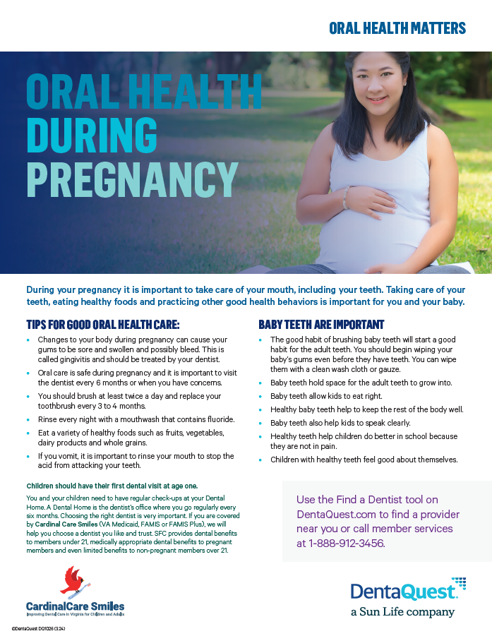

Rebranding

Slide 22
Thank you!

